Slide 2
Presentation Outline
Objectives
Background
Approach
Results
Discussion
Conclusions and Recommendations

Slide 3
Information for Presenters
15 minutes will be provided for presentations
  While, presentation may seem to be 20 minutes in length, 1 to 2 minutes is needed to introduce you at the beginning of the presentation, and 3 to 4 minutes should be left for questions and discussion at the end of your presentation
Tips to help ensure that your presentation keeps within the allotted time
  A good presentation typically has on average one slide per minute of presentation time (e.g. 15 slides for a 15 minute presentation)
  Try to avoid excessive amounts of time on background information and literature review
  Avoid text-heavy slides
  Focus on your results, conclusions and recommendations – attendees will have your paper

Slide 4
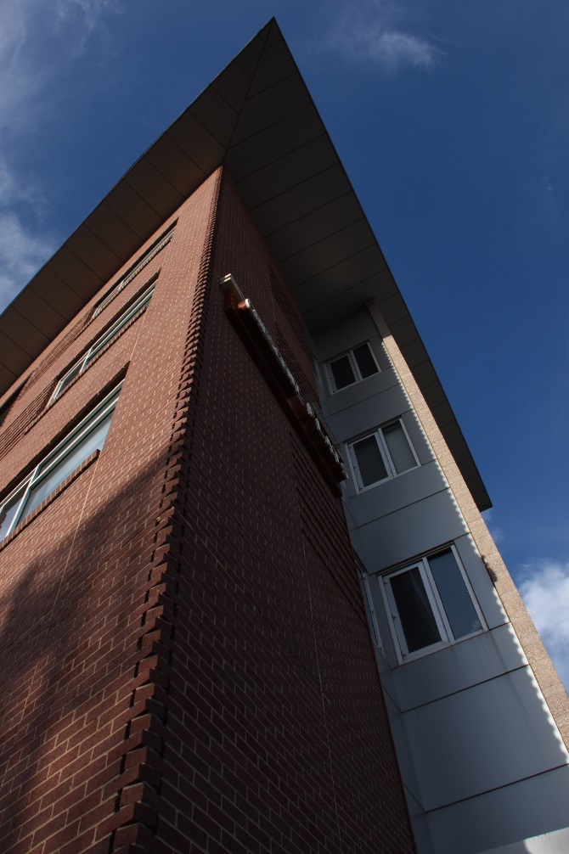
Tips on Figures & Videos
Ensure figures are clear and concise
  Photo credits should be provided when applicable
Videos should be embedded within the PowerPoint presentation
  Avoid linking to an online video source as internet connection is not guaranteed and accessing takes time
Masonry Veneer: Denver, Colorado
(Samblanet, 2018)

Slide 5
Tips on Tables
Avoid tables with lots of columns and rows.
Don’t simply copy a table from your manuscript and make it a slide.
A table should summarize important data instead of presenting all data gathered.
Use large font size and color to highlight important values.

Slide 6
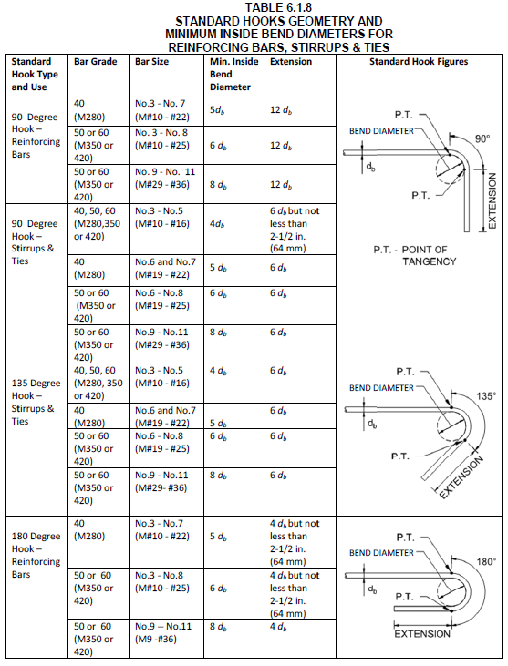
BUSY TABLE – AVOID IT

Slide 7
GOOD TABLE
Aggregate | Soak |  |  | No Soak
 | Slump
 | High | Medium | Low | High | Medium | Low
High | 2978 | 3012 | 3475 | 2475 | 2743 | 3308
Medium | 4301 | 5182 | 5701 | 3871 | 4707 | 5252
Low | 6014 | 6435 | 7110 | 6547 | 6469 | 6554

Slide 8
Giving Credit
Crediting co-authors is appropriate, but remember, you have a short amount of time, and the attendees have your paper. So list them on the title slide, but don’t spend time introducing and crediting them
Same with sponsors/supporters. It is fine to credit them, but time is limited.
If you want to add a company or institution logo, please do so on your first slide only

Slide 9
Presentation Naming
Please follow the following naming convention so we can easily assign your presentation to the correct session and identify the most recent version of your presentation if you make revisions:
  SS-O-PP#-PLN-2019-MO-DA.pptx
  Where SS is the Session Number
  O is a number from 1 to 7 for the Order of the paper within the session
  PP# is the Paper Number
  PLN is the Main Presenter's Last Name
  MO is the month of submission
  DA is the day of submission see next slide for example

Slide 10
Presentation Naming Example
If Fonseca is the presenter for paper 0102 and that paper is assigned as the 3rd paper in session 1A, his paper should be named as follows if he submits it on May 16, 2019:
1A-3-0102-Fonseca-2019-05-16.ppt

Slide 11
Presentation File Upload
Deadline June 3, 2019
If your presentation is under 20 MB in size, upload your PowerPoint Presentation file to:
  https://masonrysociety.org/13namc-presentation-submission/
If you file is over 20 MB in size please contact us at tmsaccountant@masonrysociety.org
Presentations must be uploaded by June 3rd

Slide 12
Before Your Presentation
Practice & Time Yourself.
  This helps you feel comfortable with the content, and have a good idea of the time limitations – if possible do in front of someone
Arrive to your session room at least 15 minutes prior to the start of the session so that you can introduce yourself to the moderator and meet other speakers, while hearing any special instructions
Relax, as you know the topic better than anyone, and if you’ve prepared, you will give a great presentation.

Slide 13
Acknowledgements
Thank you! We are looking forward to seeing you at the 13NAMC!

